Slide 1
Customer Database Analysis
Ben Nicholson

Slide 2
Getting to know our customers
Data Visualisation

Slide 3
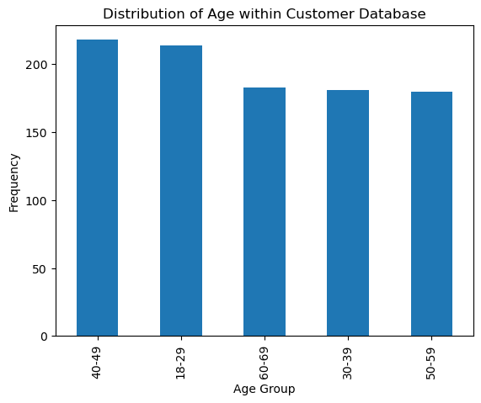
Distribution of Age

Slide 4
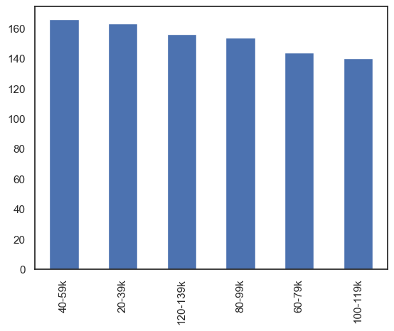
Distribution of Income

Slide 5
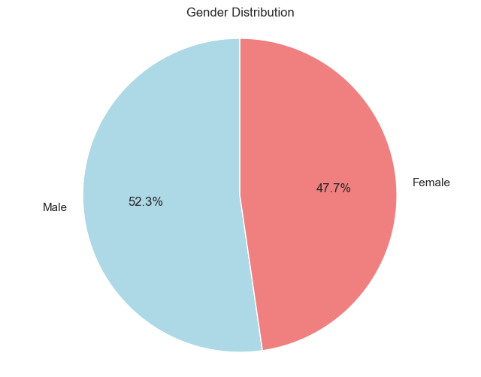
Gender Distribution

Slide 6
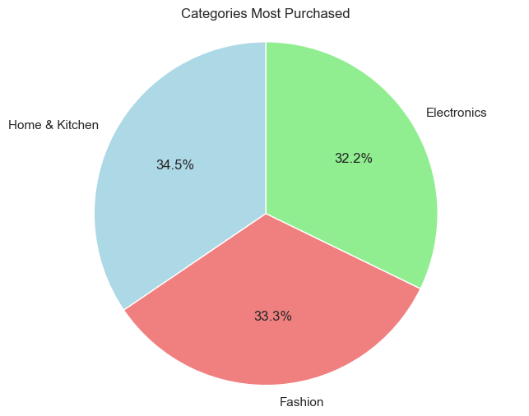
Categories Most Purchased

Slide 7
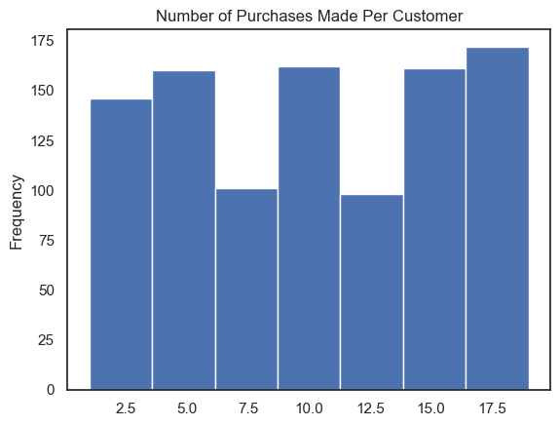
Number of Purchases Made per Customer

Slide 8
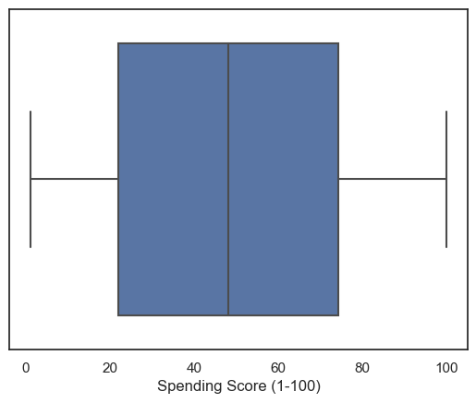
Spending Score (1-100) of Customers

Slide 9
Creating Customers Personas
Using Data Aggregation

Slide 10
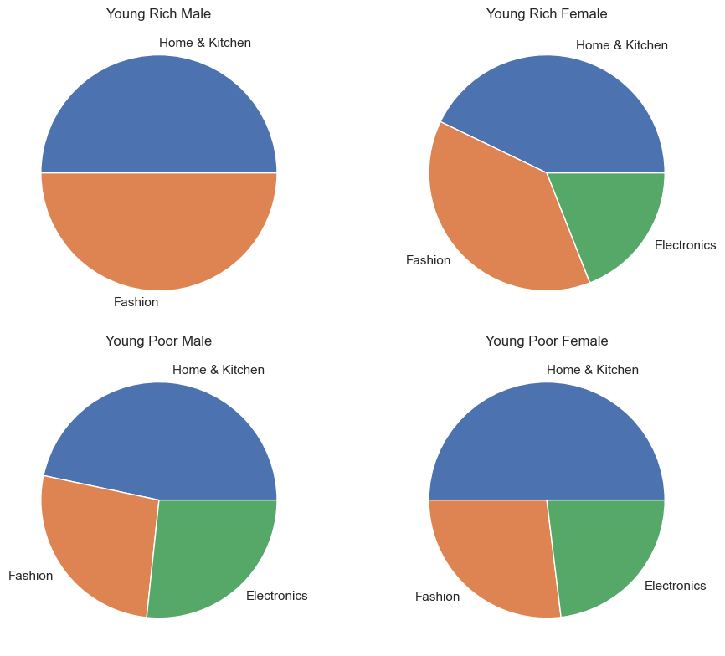
Category of Most Purchased Items for young customers

Slide 11
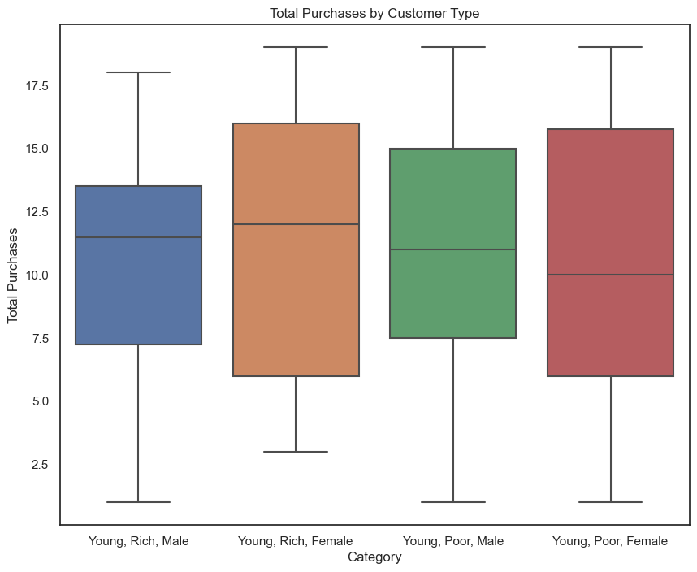
Total Purchases made by young customers

Slide 12
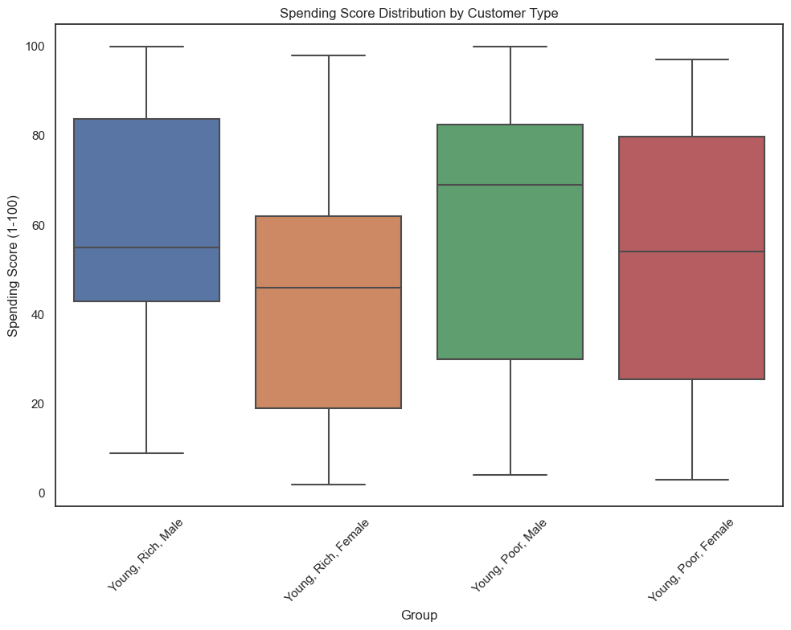
Spending Score for young customers

Slide 13
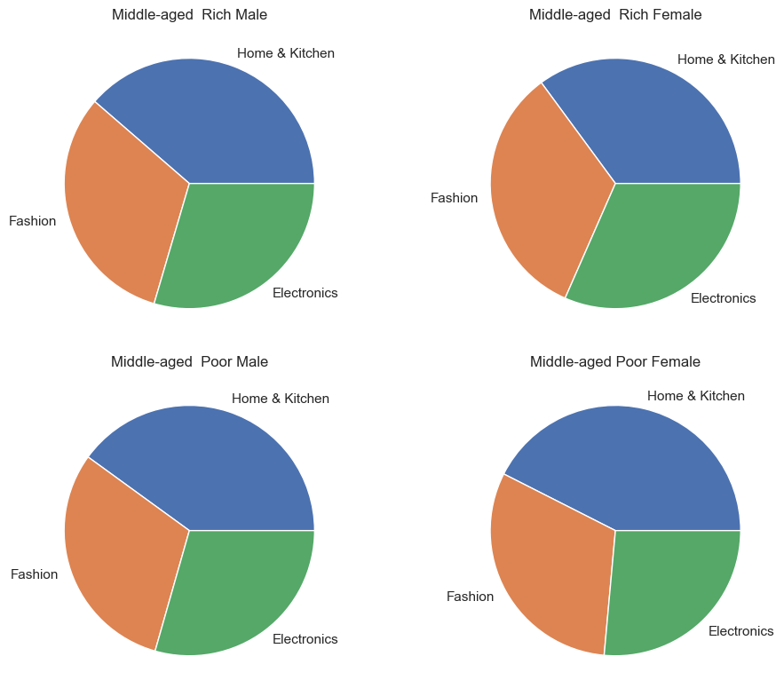
Category of Most Purchased Items for middle-aged customers

Slide 14
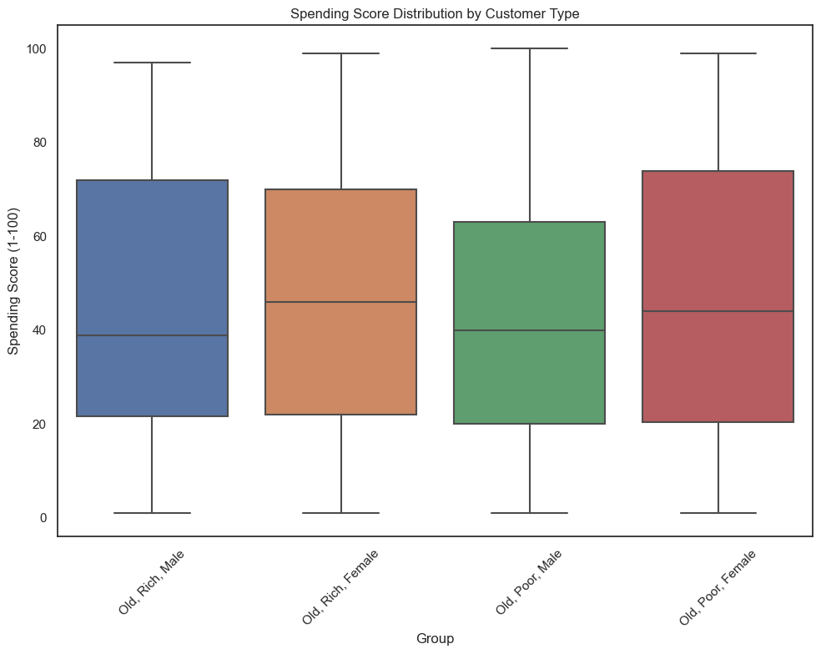
Spending Score for middle-aged customers

Slide 15
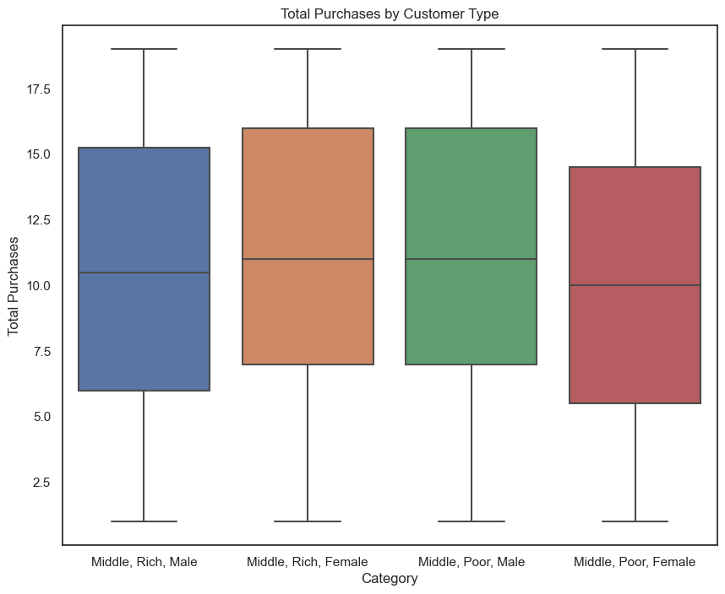
Total Purchases made by middle-aged customers

Slide 16
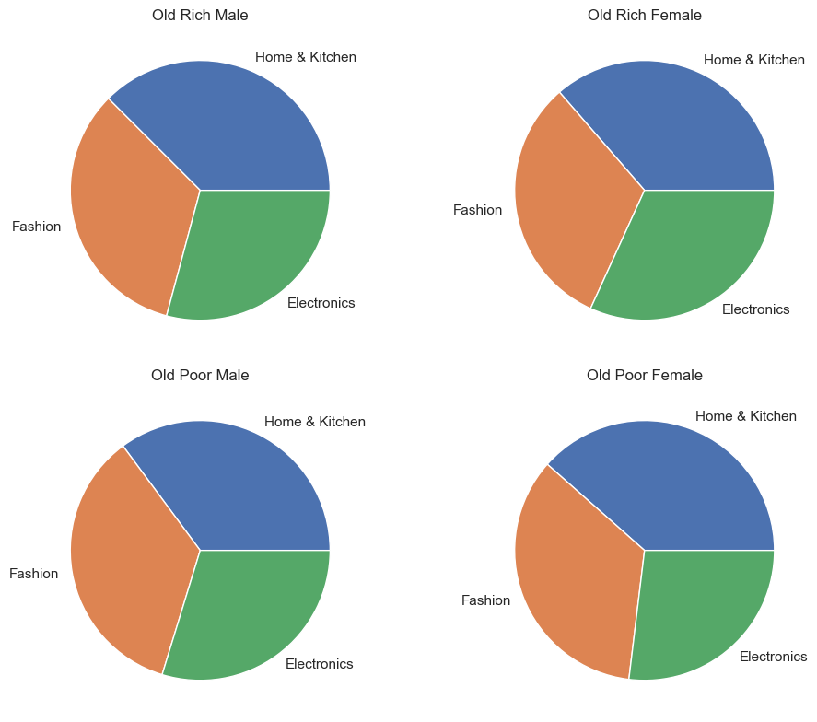
Most Purchased Category for old customers

Slide 17
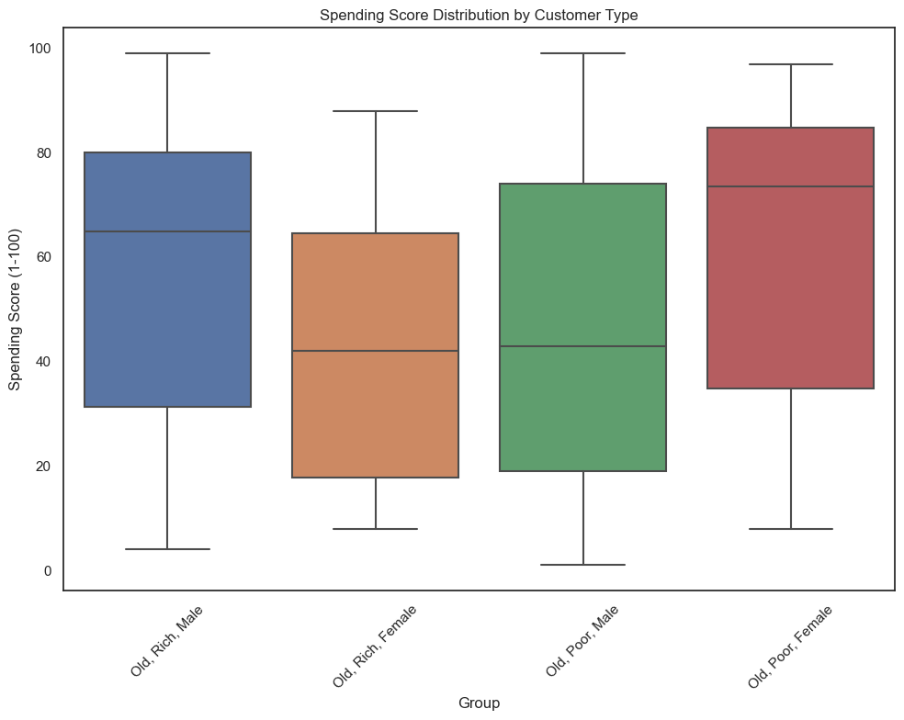
Spending Score for old customers

Slide 18
Total Purchases made by old customers

Slide 19
Predicting Customer Behavior
Clustering & Correlations

Slide 20
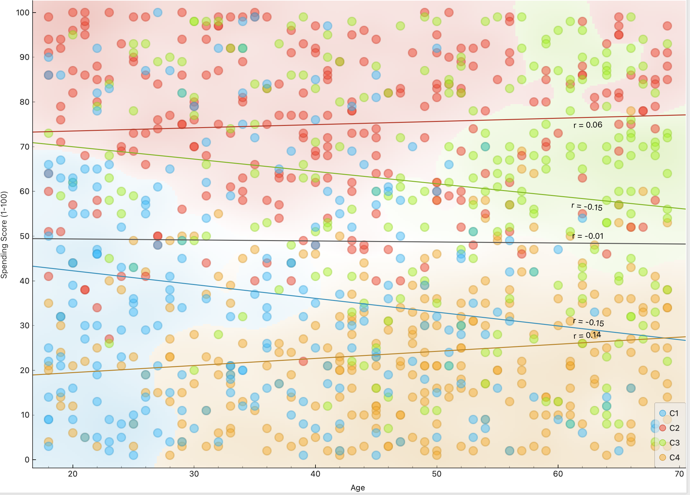
Age vs Spending Score Clustering

Slide 21
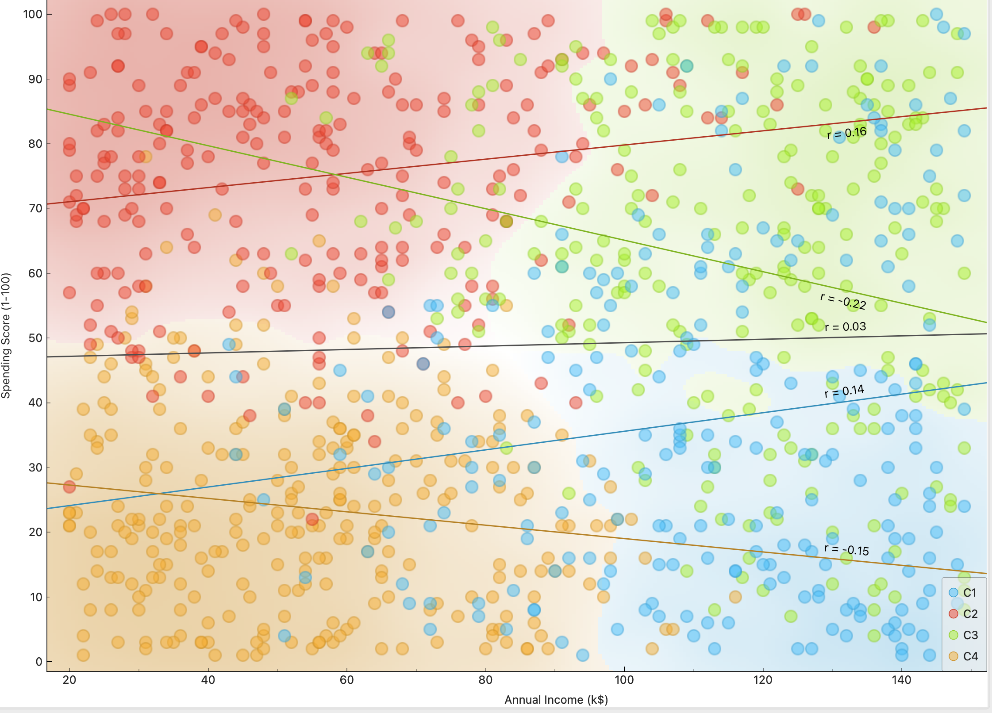
Annual Income vs Spending Score (1-100)

Slide 22
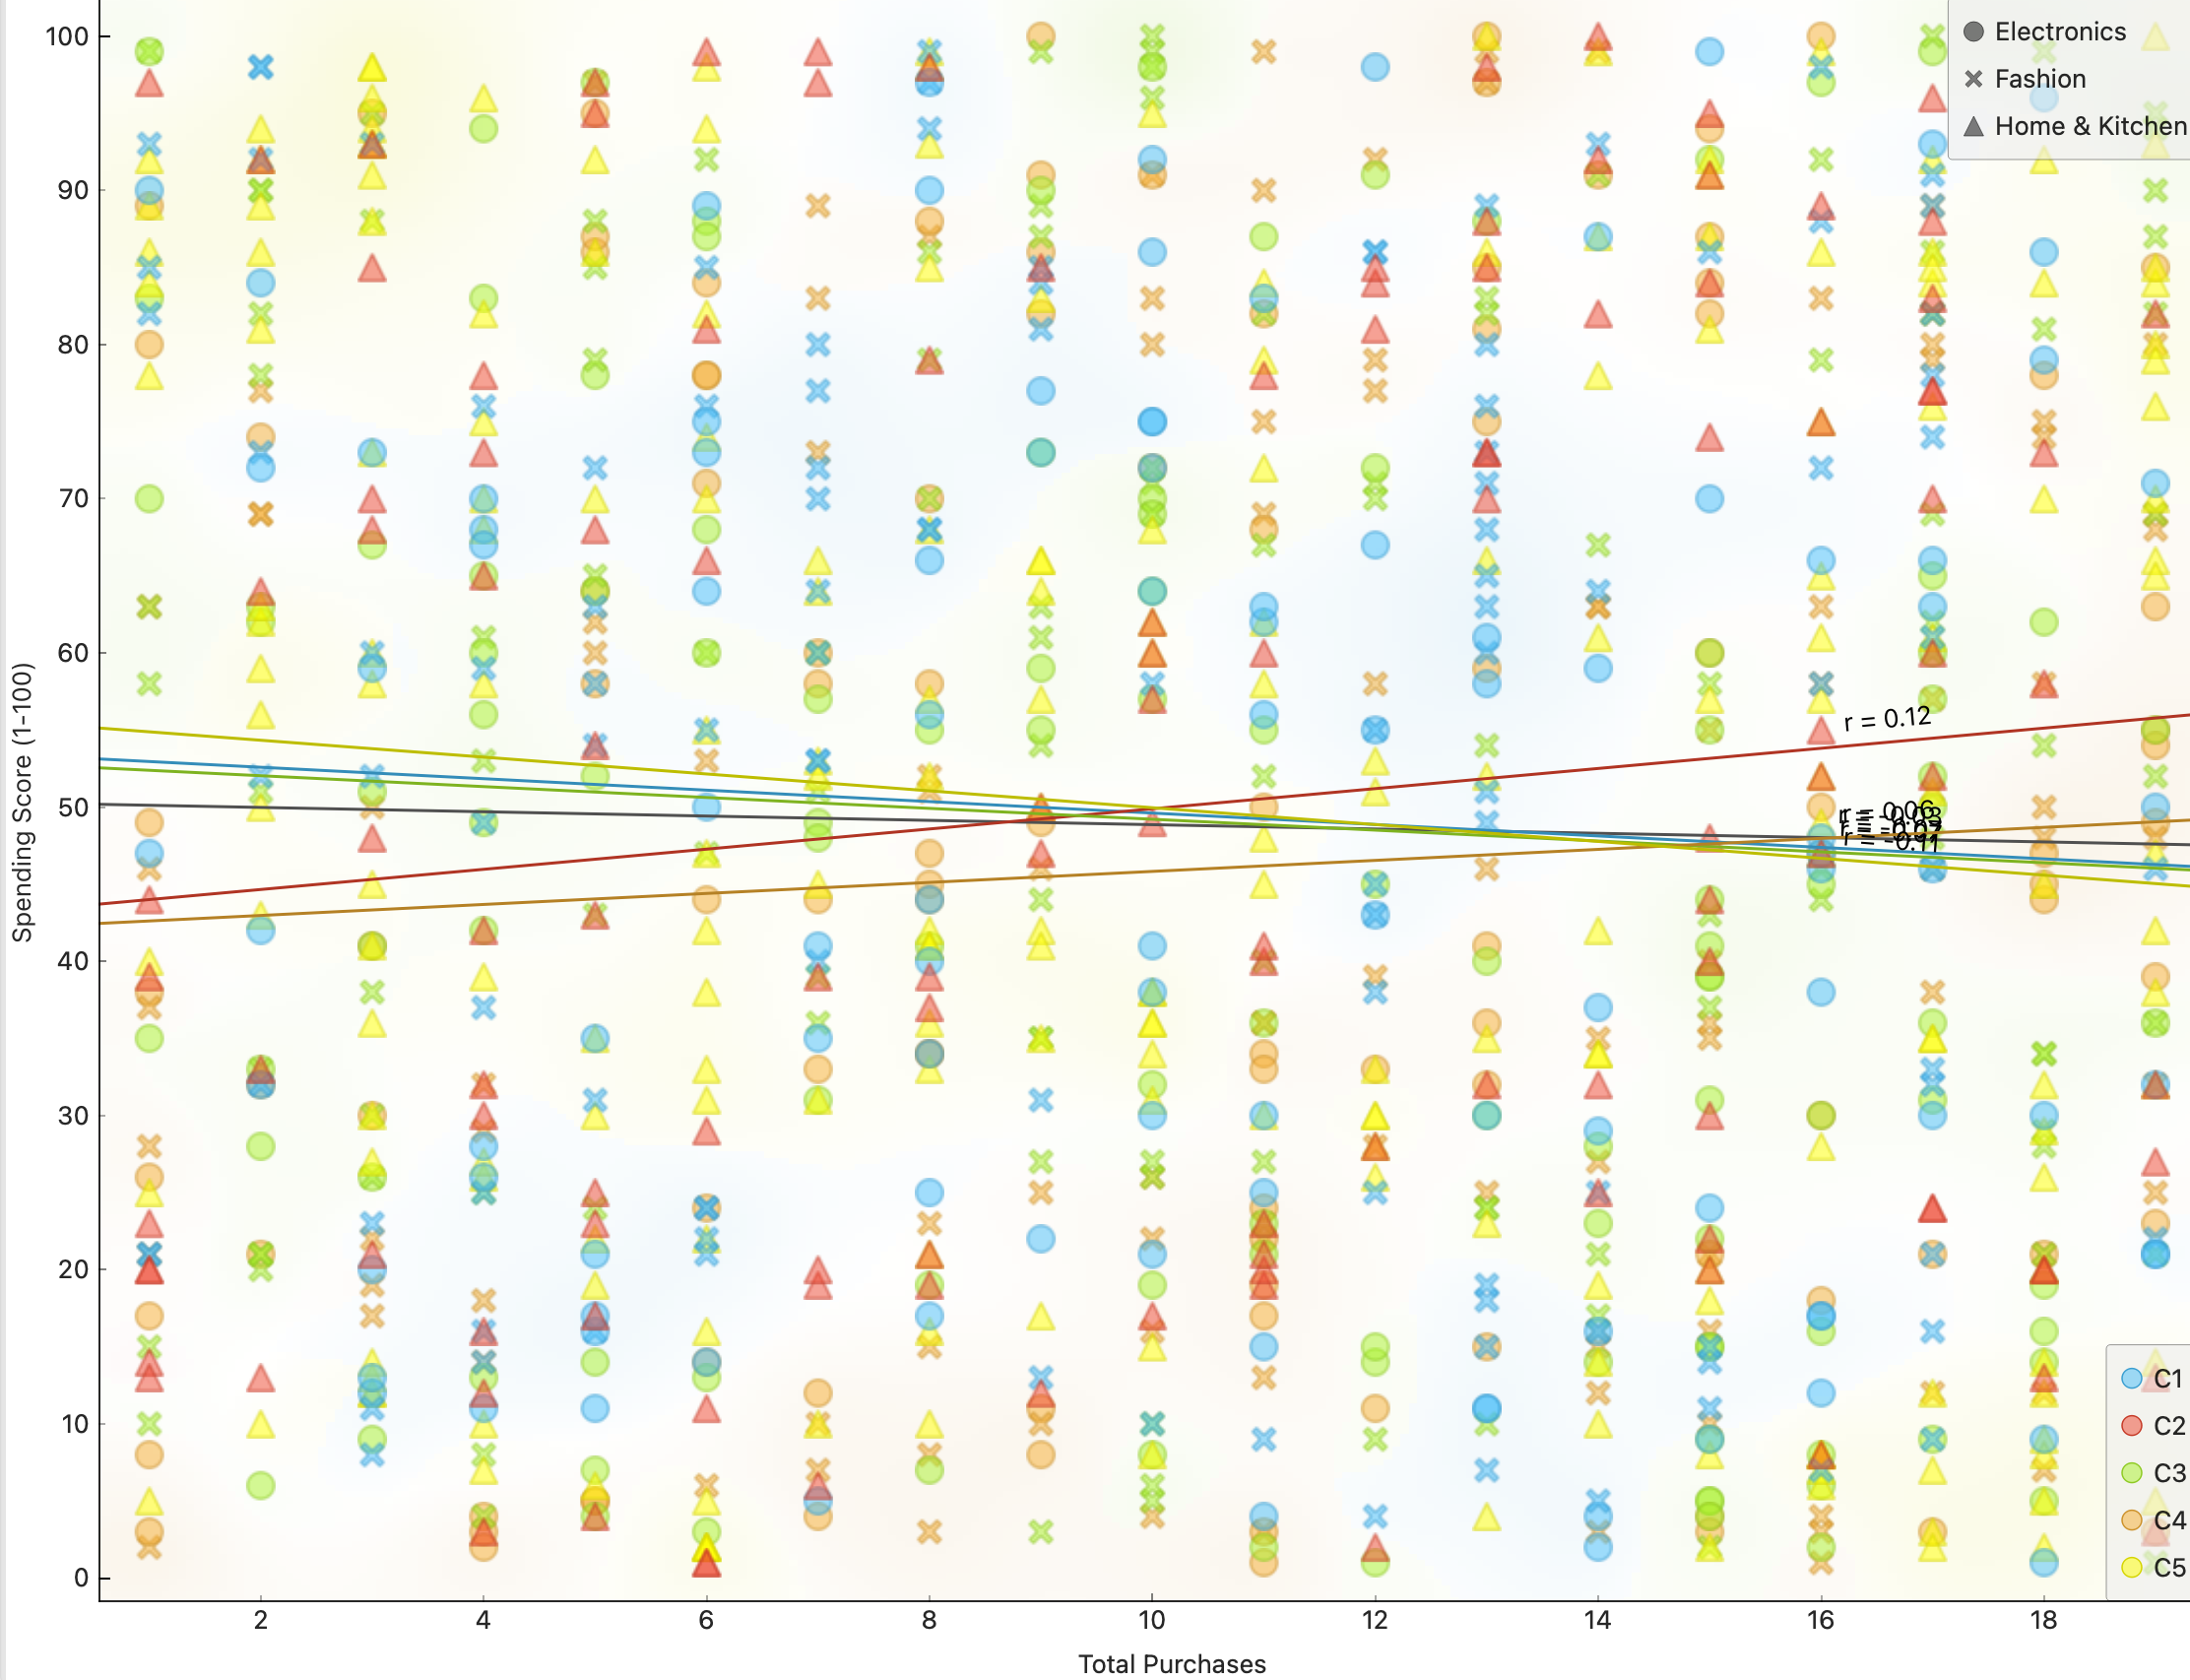
Total Purchases vs Spending Score (1-100)

Slide 23
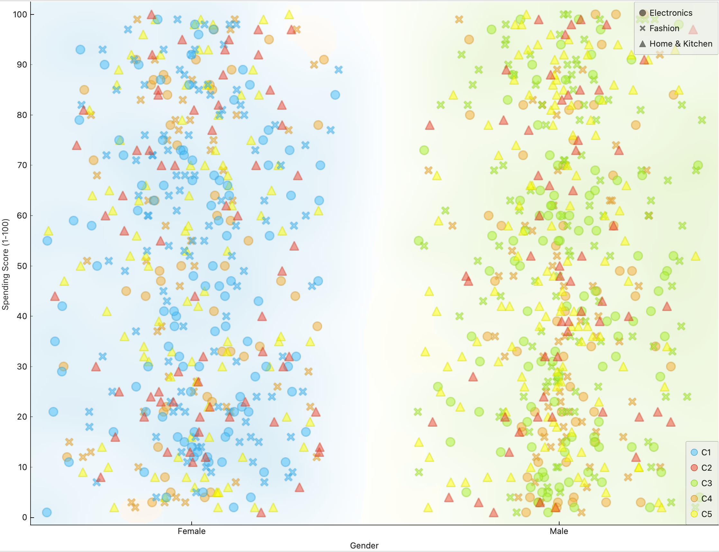
Gender & Category vs Spending Score (1-100)

Slide 24
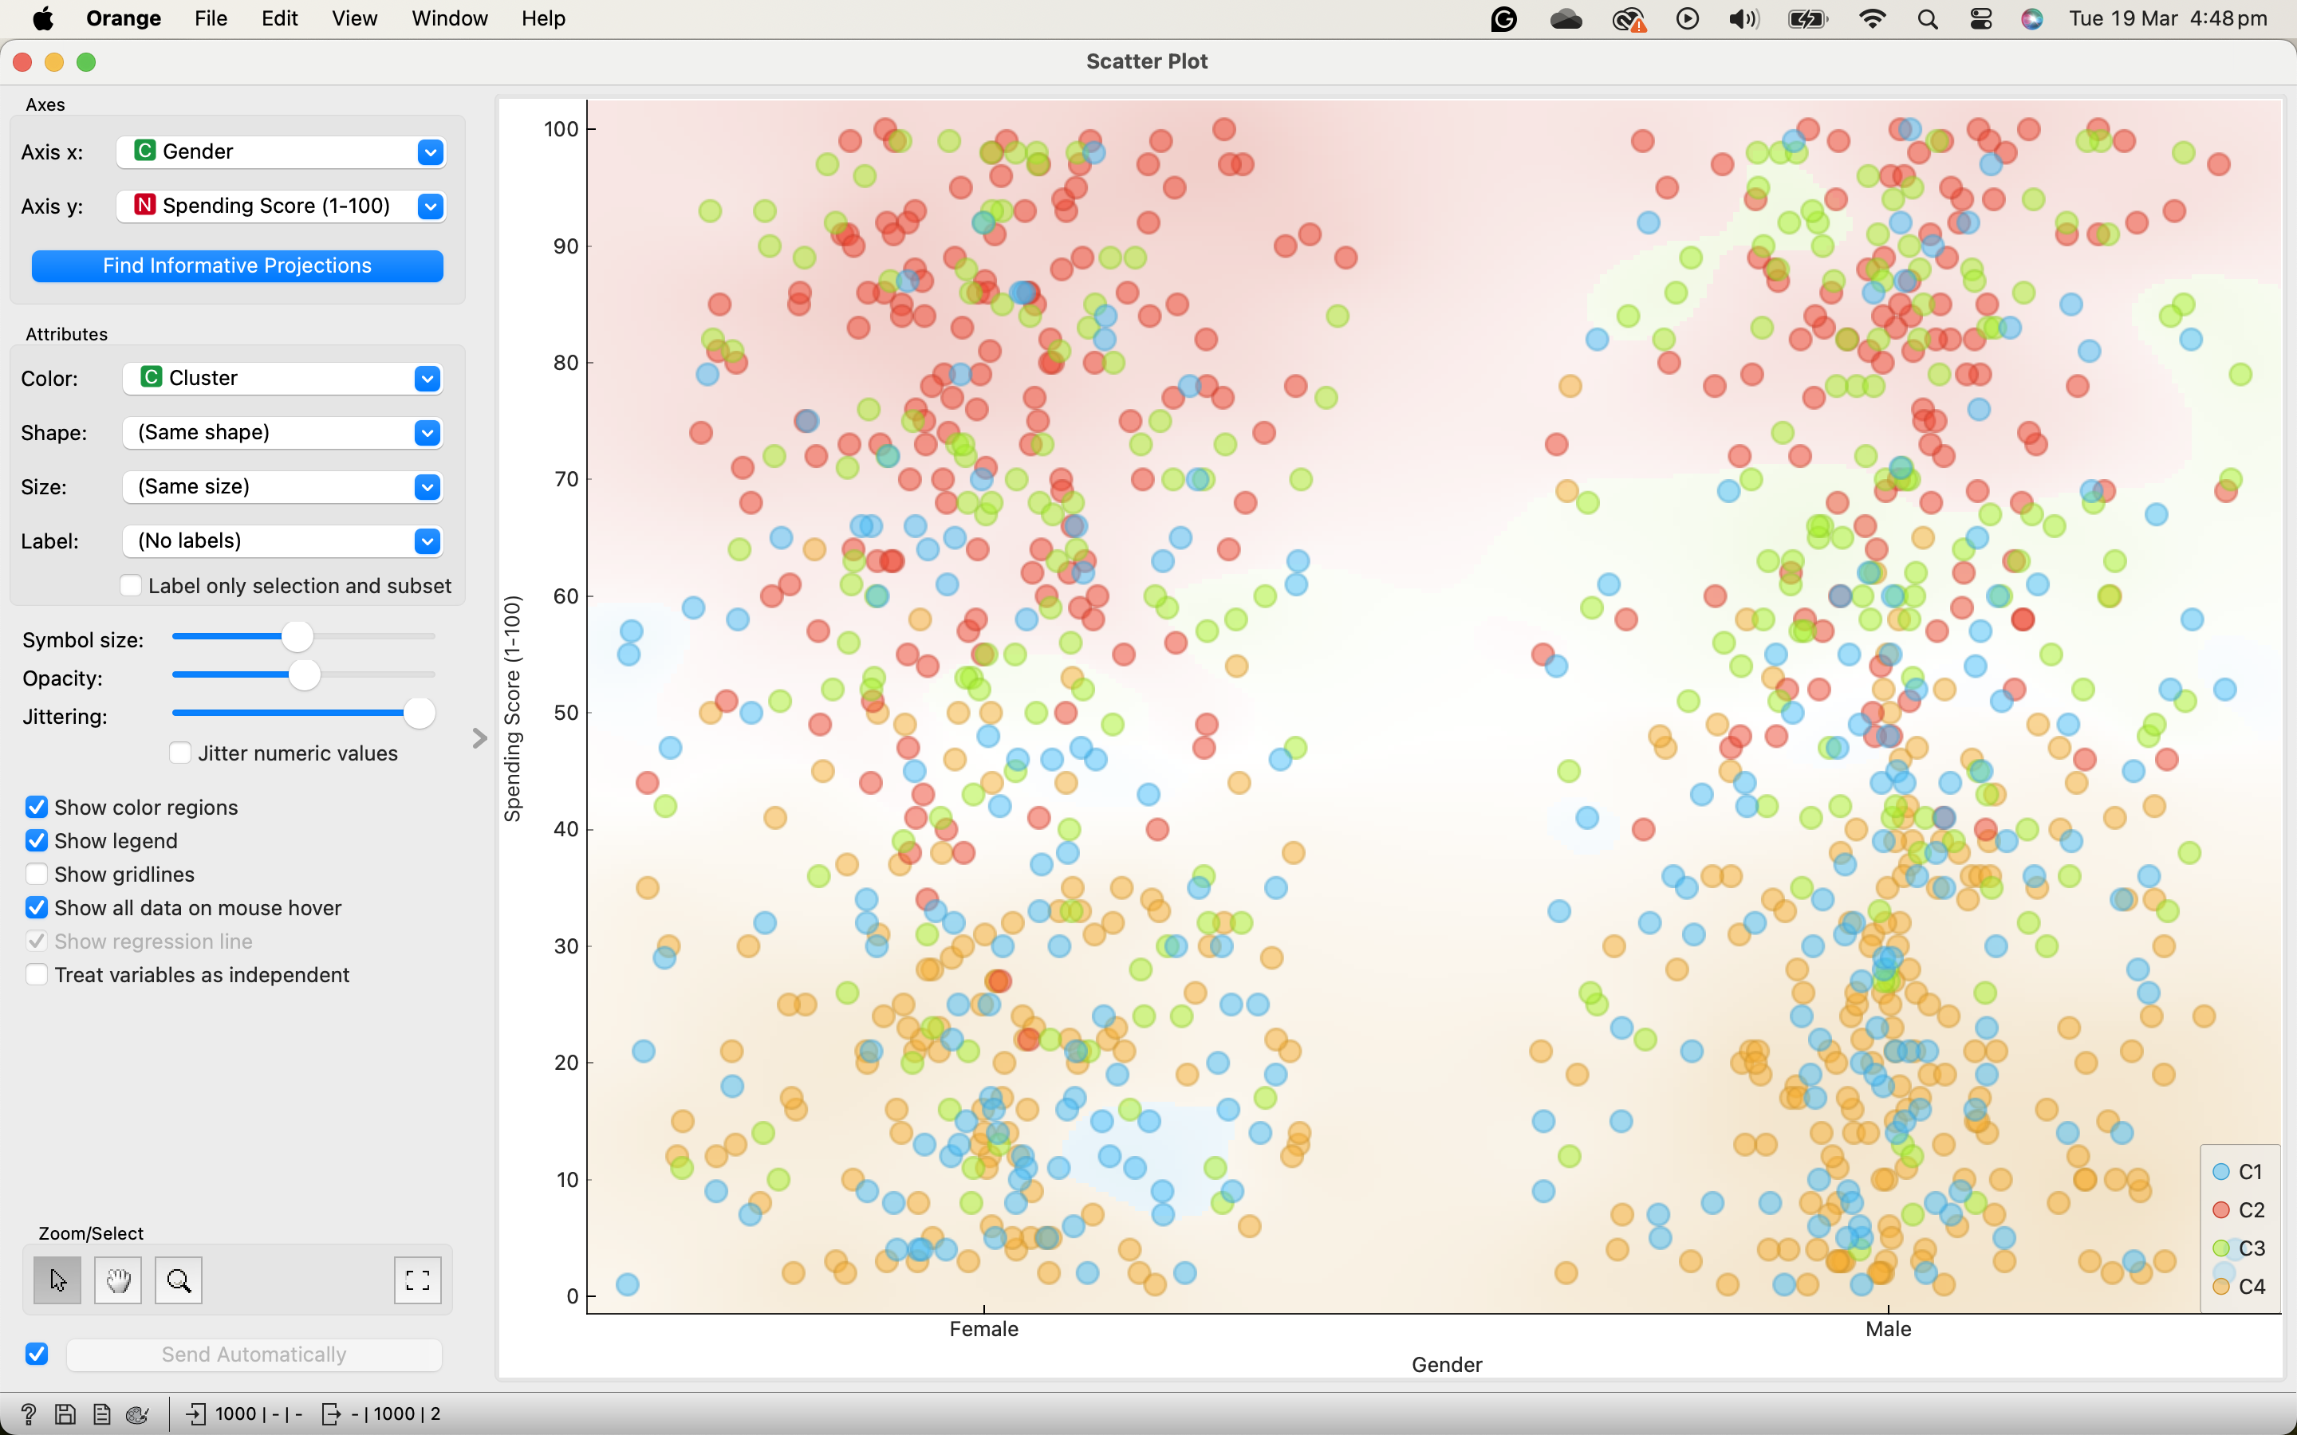
Genders vs Spending Score (1-100) with Clustering

Slide 25
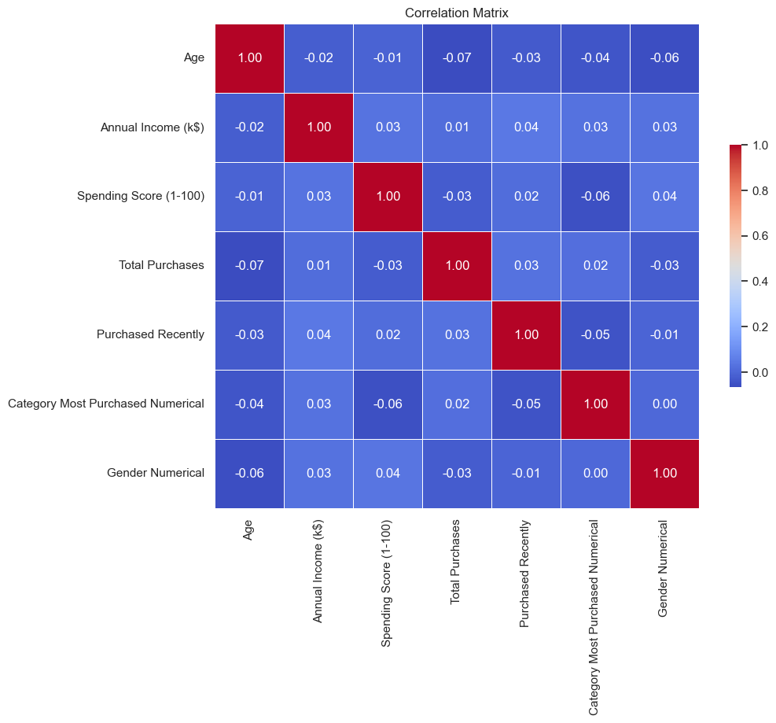
Correlation Matrix

